Slide 1
Intelligent Traffic Light Simulator using YOLOv5
Project by Hamza Tariq, Faizan Ali, Talmeez-Ur-Rehman,
Project Title
Group Members
Course & Semester
Intelligent Traffic Light Simulator using YOLOv5
Hamza Tariq, Faizan Ali
Operating System, 4 Semester
Talmeez-Ur-Rehman,

Slide 2

Intelligent Traffic Light Simulator using YOLOv5
Welcome to this presentation on an innovative Intelligent Traffic Light Simulator leveraging the power of YOLOv5 for real-time vehicle detection and adaptive traffic control. As urban centers become increasingly crowded, smart traffic management is essential to reduce congestion, improve travel times, and enhance safety.
This project aims to simulate an adaptive traffic signal that dynamically adjusts based on vehicle density, moving beyond traditional fixed-timer approaches. Our group’s effort combines computer vision, deep learning, and real-time processing to demonstrate this solution's potential in smart city applications.

Slide 3
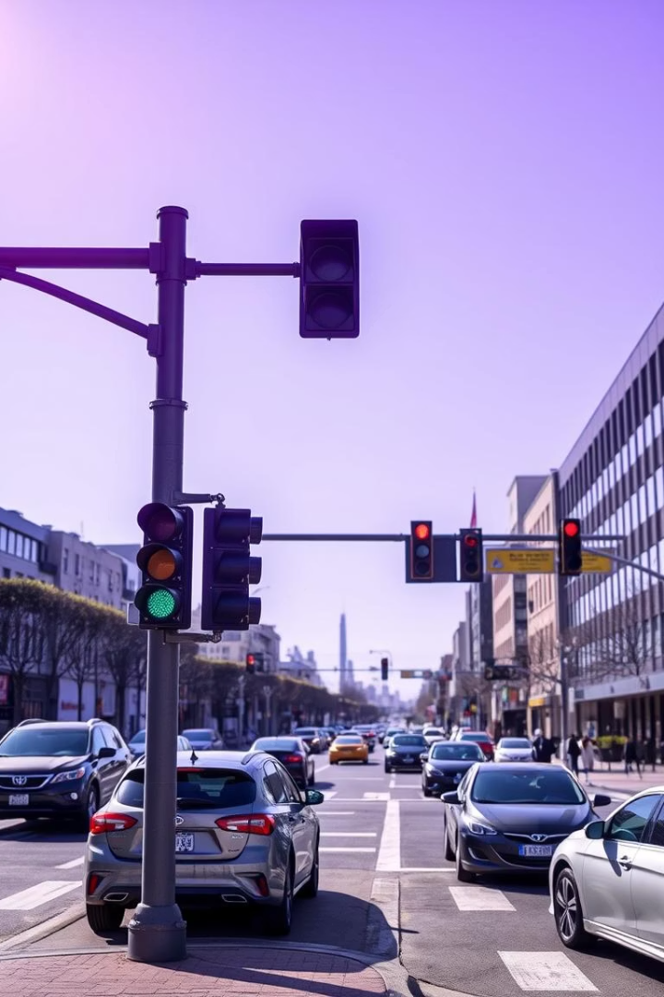
Introduction to Traffic Light Simulation and Smart City Traffic Control
What is a Traffic Light Simulator?
A tool that mimics real-world traffic light operations to test signal timing, traffic flow, and control strategies under varied conditions without physical deployment.
Importance of Traffic Control in Smart Cities
Efficient traffic management minimizes congestion, reduces pollution, improves safety, and ensures smoother transportation systems critical for urban development.

Slide 4
Problem Statement: Challenges and Needs
Challenges with Fixed-Timer Signals
Need for Adaptive Signal Systems
Inflexible timing unsuited for fluctuating traffic volumes
Dynamically adjust based on real-time vehicle data
Optimize traffic flow and minimize delays
Causes unnecessary waiting times and increased congestion
Leverage computer vision and AI for intelligent control
Lack of responsiveness to unexpected traffic conditions

Slide 5

Project Objectives
Adaptive Red Light Timing
Vehicle Detection via Computer Vision
Automatically modify red light duration in response to vehicle density on approaches.
Utilize YOLOv5 deep learning model to detect and count vehicles from live video input accurately.
Real-time Traffic Signal Control
Integrate detection results to dynamically control traffic lights, enhancing flow and reducing congestion.

Slide 6
Literature Review and Tools Selection
Existing Traffic Simulation Tools
Why YOLOv5 and OpenCV?
SUMO: Open-source microscopic traffic simulator for multiple scenarios
YOLOv5 offers high-speed, accurate real-time object detection
VISSIM: Commercial software with detailed traffic modeling capabilities
OpenCV provides powerful video processing and image manipulation functions
Python ecosystem supports rapid prototyping and integration of both

Slide 7
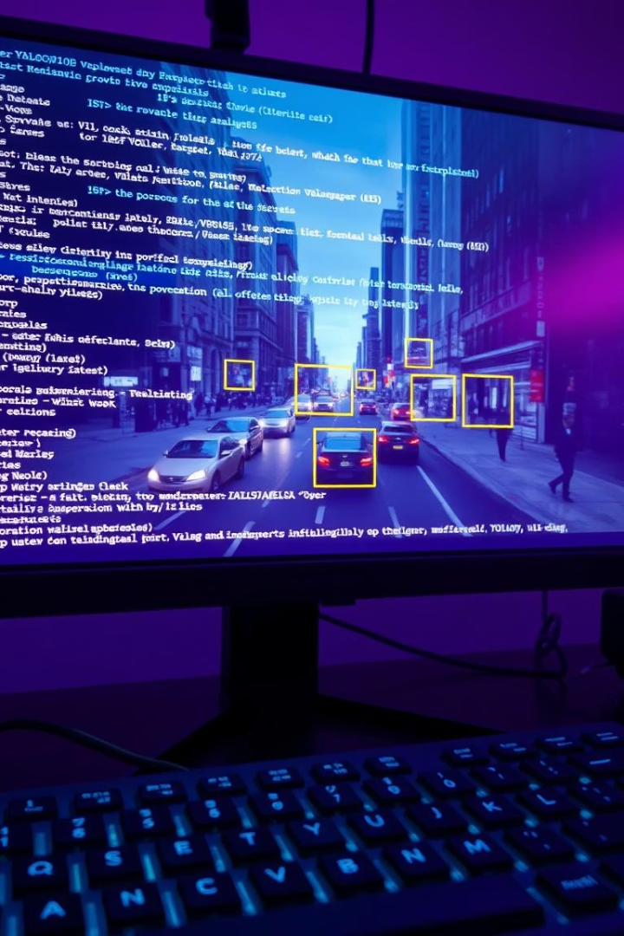
Tools and Technologies Used
Programming Language
Key Libraries
OpenCV for video stream processing, PyTorch framework housing YOLOv5 for real-time object detection.
Python: Chosen for its extensive libraries and simplicity in AI and image processing.
Other Components
Use of annotated traffic video footage as input data for vehicle detection and adaptive light control.

Slide 8





System Design and Architecture
Video Input
Capture live or recorded video feed of traffic intersection.
Vehicle Detection
YOLOv5 detects and classifies vehicles frame-by-frame.
Counting Vehicles
Count vehicles within defined regions of interest (ROI).
Signal Timing Adjustment
Calculate optimal red light duration based on vehicle density.
Display Output
Show updated signals and annotated video frames to users.

Slide 9
Algorithm and Implementation Details
Region of Interest (ROI) Selection
Vehicle Counting Logic
Red Light Duration Formula
Detected vehicle bounding boxes crossing a virtual line within ROI increase the count used for timing decisions.
Adjust red light time proportionally based on vehicle count, ensuring responsive and efficient traffic flow management.
Specific areas in video frames are defined to focus detection and counting efforts on lanes affecting signal timing.

Slide 10
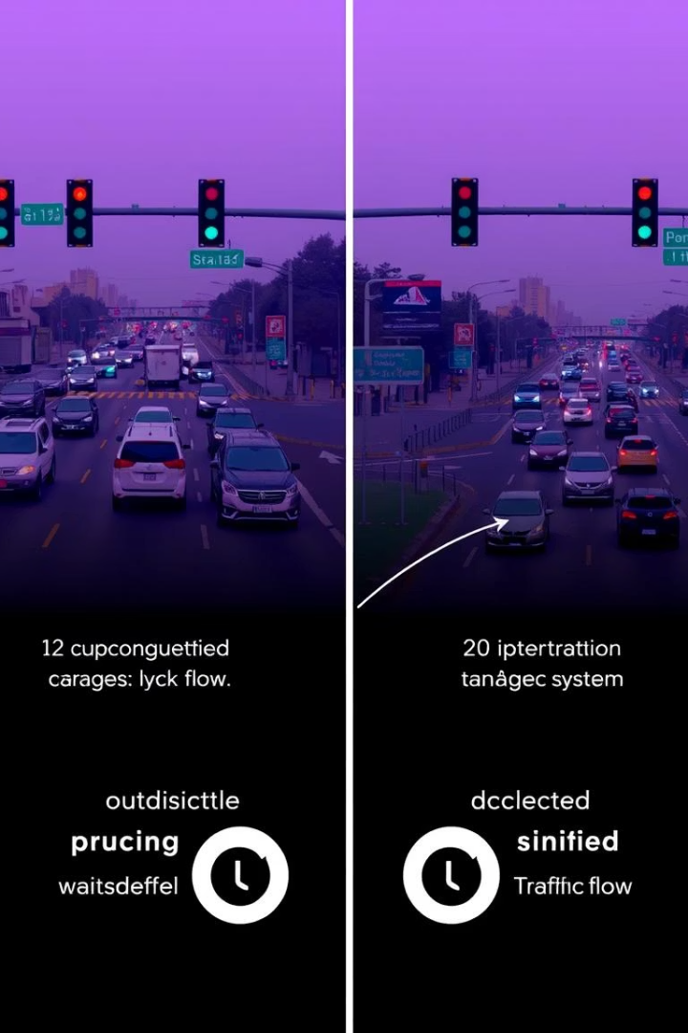
Results, Observations, and Future Work
Performance Observations
Limitations
Adaptive system reduces wait times substantially during heavy traffic; vehicle detection accuracy remains high despite video quality variations.
Low-resolution or occluded videos can reduce detection accuracy; current model does not address pedestrian detection or full crossroad complexity.
Future Improvements
Incorporate pedestrian presence, multiple lanes and directions, and real-world deployment with IoT sensor integration for enhanced smart city solutions.

